Slide 1
HTT splicing enhancer off-target effects
Issues about cross-cells/cross-batches comparison
Nov 18, 2022
Zhen, Dann, Catherine, Joon, Magnus, Jessica

Slide 2
Key points:
Goals of study/analysis
Study design
Summary of QC of results
Deep dive into off targets, e.g
Visualizations of OT frequencies, rankings, etc.
Similarities/differences between compound profiles in each cell type
Similarities/differences between cell types

Slide 3
Goal:
Find the compounds have less off-targets effects while keep the strong on-target effects
Explore the common targets induced by different group of compounds
Explore new splicing target for potential novel targets
Find the cell system meet the requirement of research of compounds splicing effects
Find the proper experiment design with robust and cost-efficient
Find the good experimental parameters for QC
Find the best procedure for cross-experiments/cross cell systems results comparison.
Sep 26, 2022
Zhen, Dann, Catherine, Joon, Magnus, Jessica

Slide 4
Design

Slide 5
QC

Slide 6
Design: compounds , cells
RNAseq (# of off-targets) |  | BIO-1755497 (Branaplam) |  | BIO-2006152 (PTC lead, Run 1) |  | BIO-2006152 (PTC lead, Run 2) |  | BIO-2197294 (PTC518) |  | BIO-1949634 (Risdiplam) |  | BIO-2175420 |  | BIO-2139701
Protein IC50 | RNA IC50 | 16 nM | 5 nM | 32 nM | 16 nM | 32 nM | 16 nM |  |  | 1500 nM | - | 11 nM | 8 nM | 38 nM | 19 nM
iPSC (3x IC50) | NGN2 (3x IC50) | 66 | 182 | 44 | 95 | 32 | 66 |  |  | 882 | 710 | 57 | 131 | 32 | 40
iPSC (10x IC50) | NGN2 (10x IC50) | - | - | 102 | 217 | 123 | 164 |  |  | 2147 | 1328 | 116 | 168 | 89 | 132
External SMN data: 18 off-targets
at 10x IC50 (170 nM)
6

Slide 7
Number of differentially spliced genes from RNAseq analysis
Design: compounds , cells
RNAseq (# of off-targets) |  | BIO-2174748 |  | BIO-2176866 |  | BIO-2186960 |  | BIO-2186527 |  | BIO-2184088 |  | BIO-2184090
Protein IC50 | RNA IC50 | 74 nM | 346 nM | 125 nM | 76 nM | 32 nM | 22 nM | 36 nM | 36 nM | 28 nM | 15 nM | 86 nM | 46 nM
iPSC (3x IC50) | NGN2 (3x IC50) | 32 | 60 | 59 | 62 | 24 | 61 | 24 | 52 | 47 | 76 | 31 | 55
iPSC (10x IC50) | NGN2 (10x IC50) | 101 | 173 | 211 | 139 | 79 | 177 | 75 | 127 | 137 | 194 | 66 | 137
7

Slide 8
Sample similarity from Gene Expression (1st exp)
PCA in 2D for iPSC
PCA in 2D for NGN2

Slide 9
Sample similarity from Gene Expression (2nd exp raw)
PCA in 2D for iPSC
PCA in 2D for NGN2

Slide 10
Sample similarity from Gene Expression (2nd exp raw after removal of low-quality samples)
PCA in 2D for iPSC
PCA in 2D for NGN2

Slide 11
Sample similarity from Gene Expression (2nd exp raw after removal of R4)
PCA in 2D for iPSC
PCA in 2D for NGN2

Slide 12
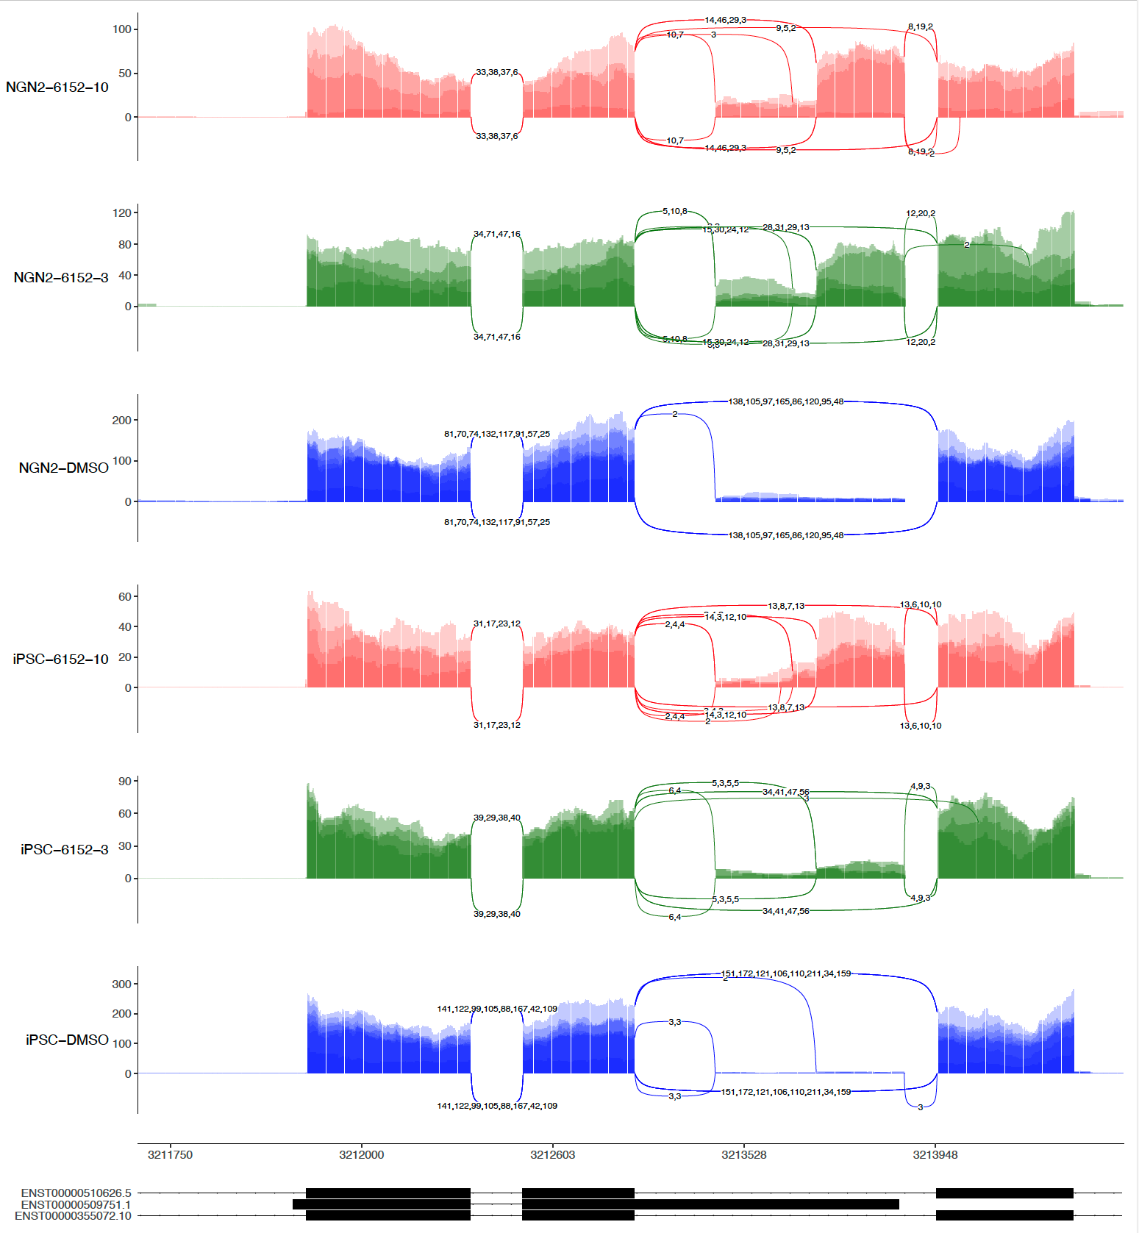
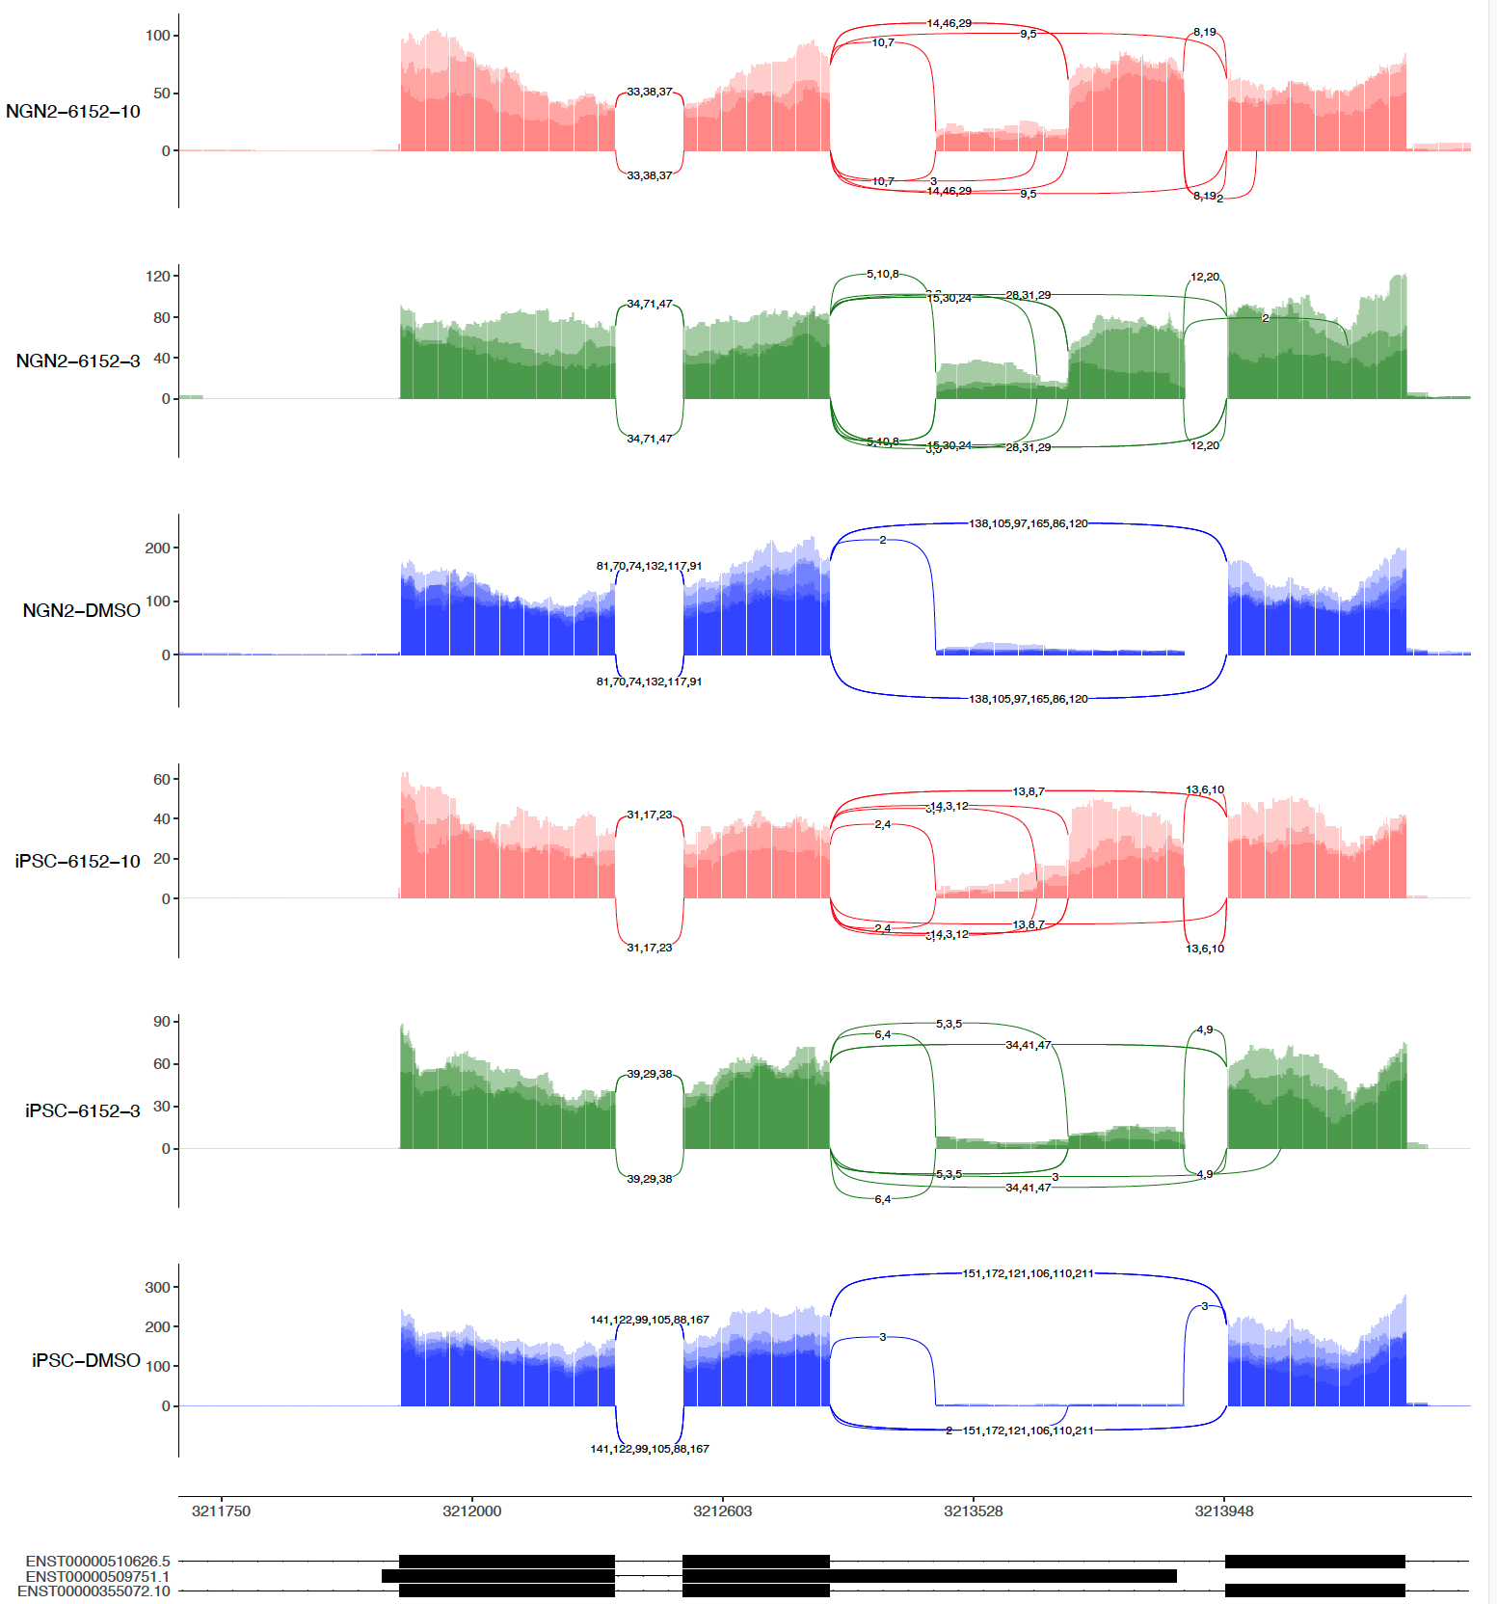
sashimi-plots: 2nd 6152
4 repeats
3 repeats (No R4)

Slide 13
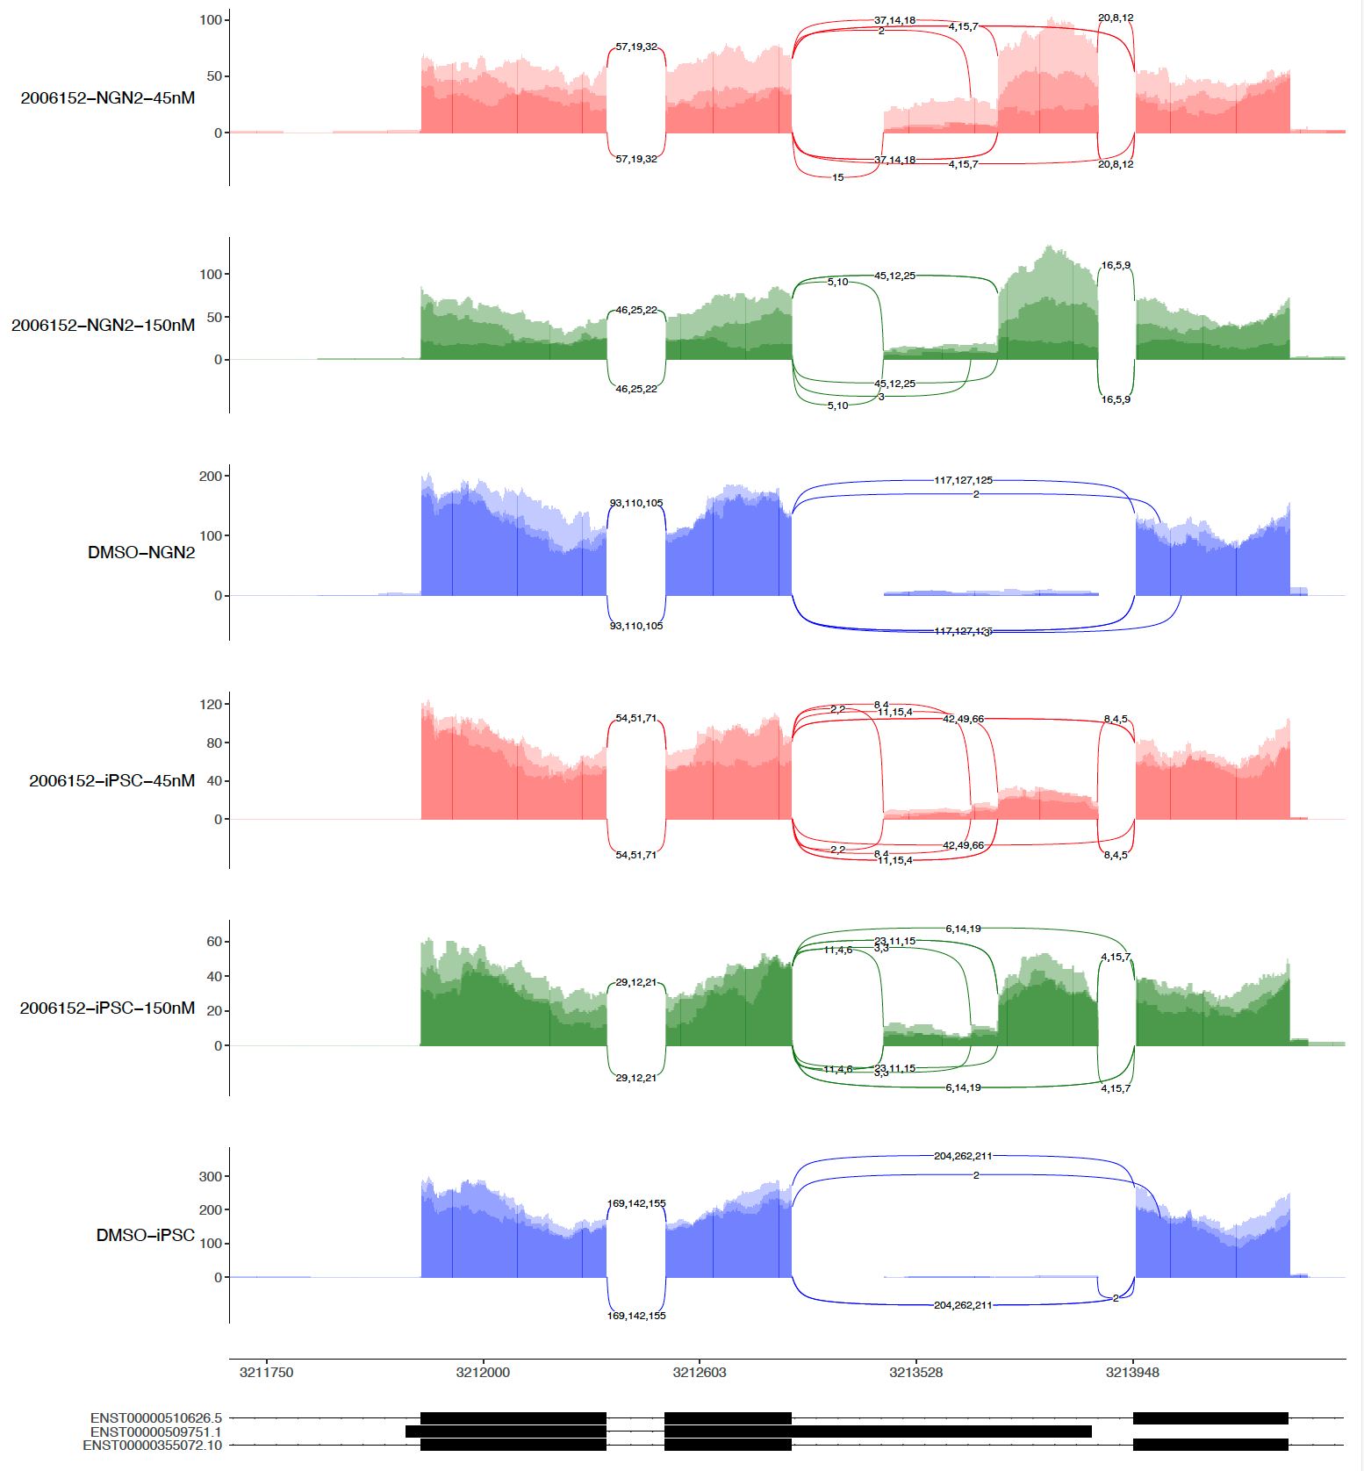
sashimi-plots: 1st 6152 and 2nd 6152

Slide 14
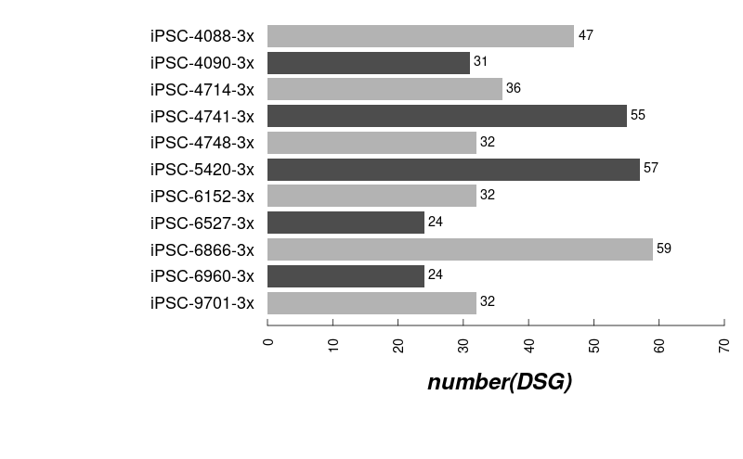
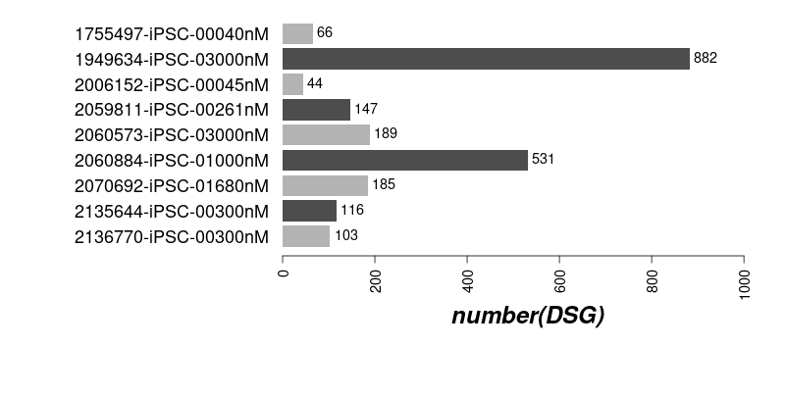
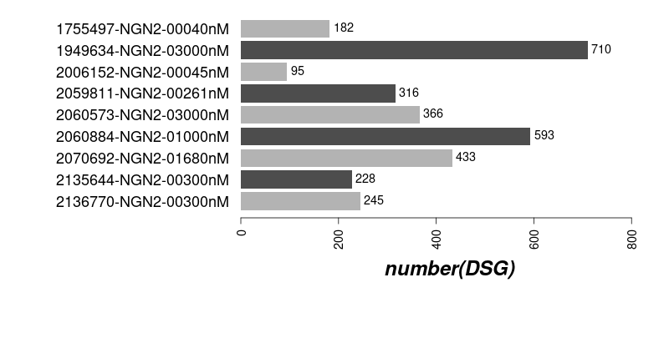
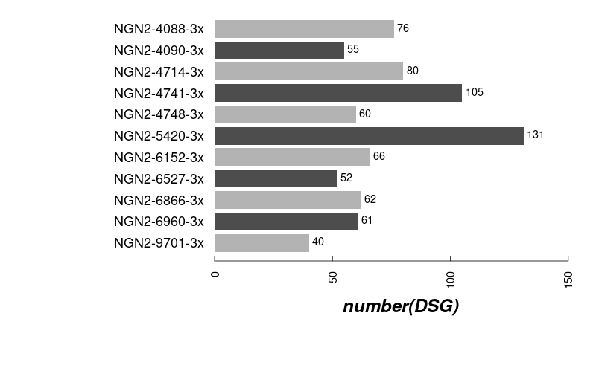
The numbers induced by compounds (3x)

Slide 15
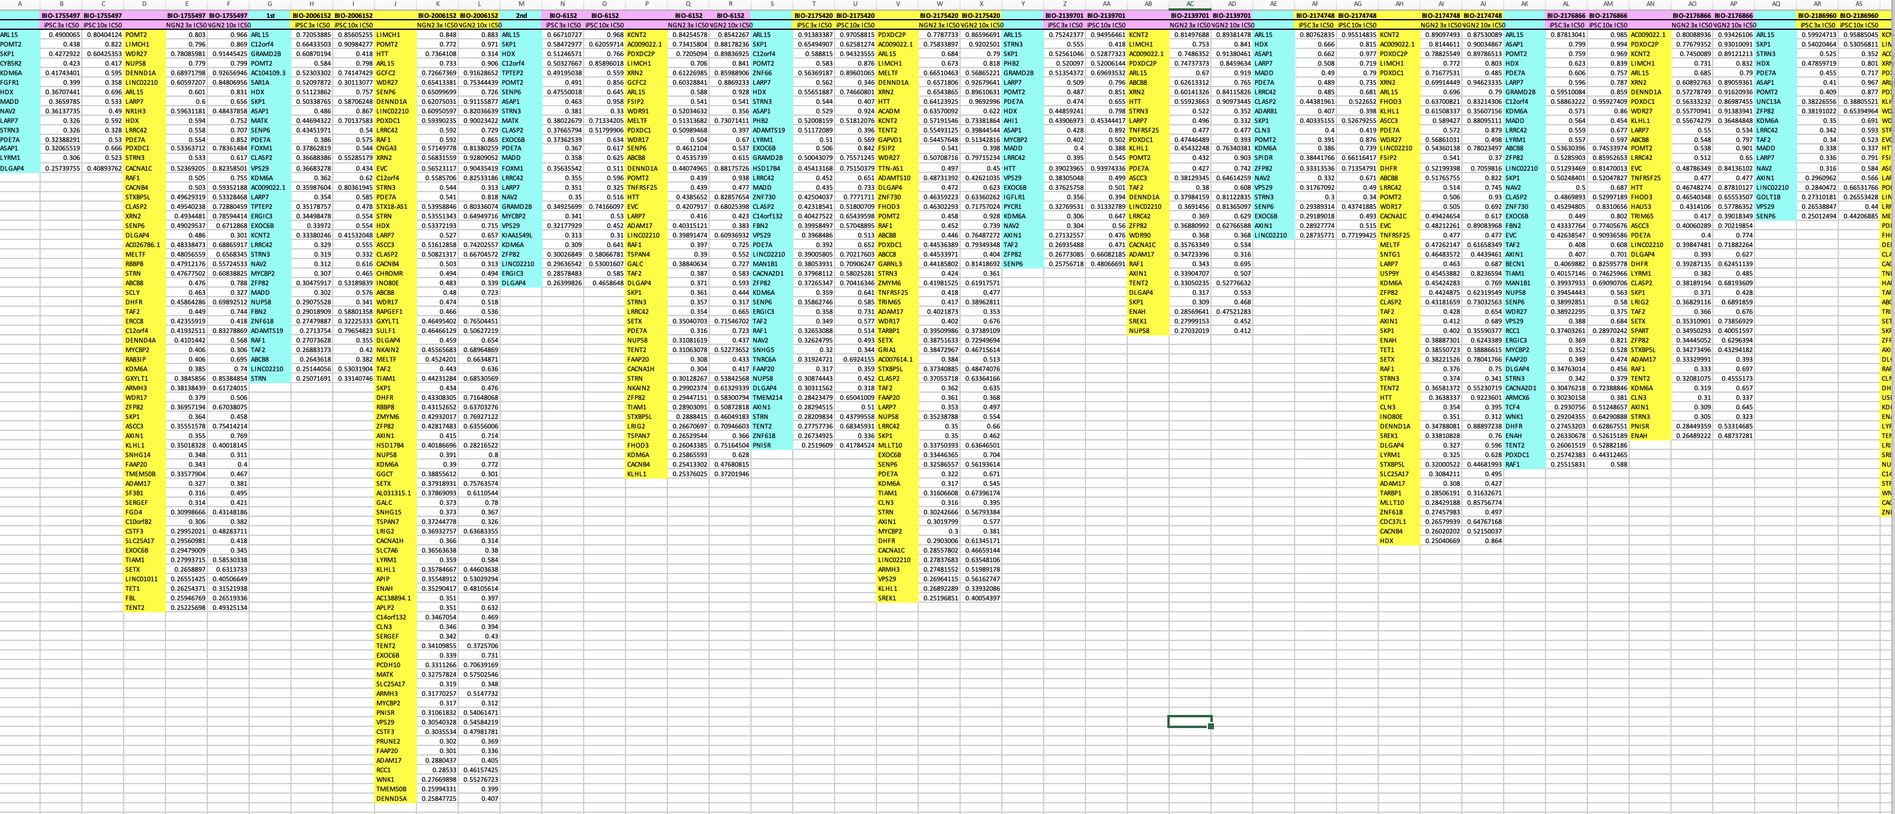
Overlapped DSG (iPSC vs NGN2)

Slide 16
Two big excel tables

Slide 17
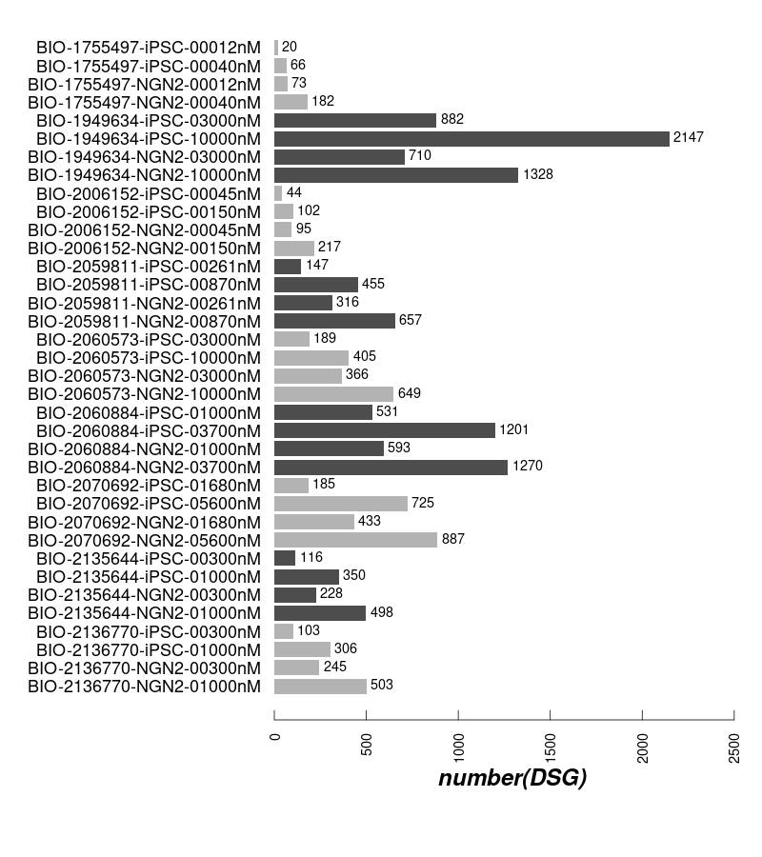
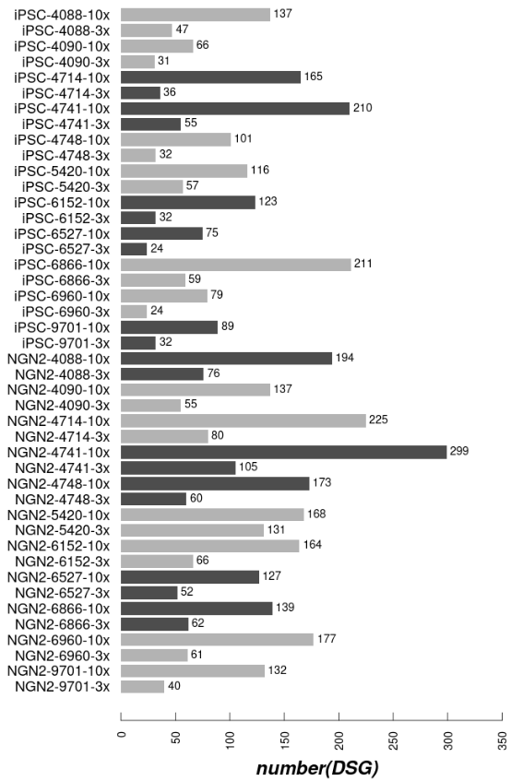
DSG: 1st batch and 2nd batch
1st batch
2nd batch

Slide 18
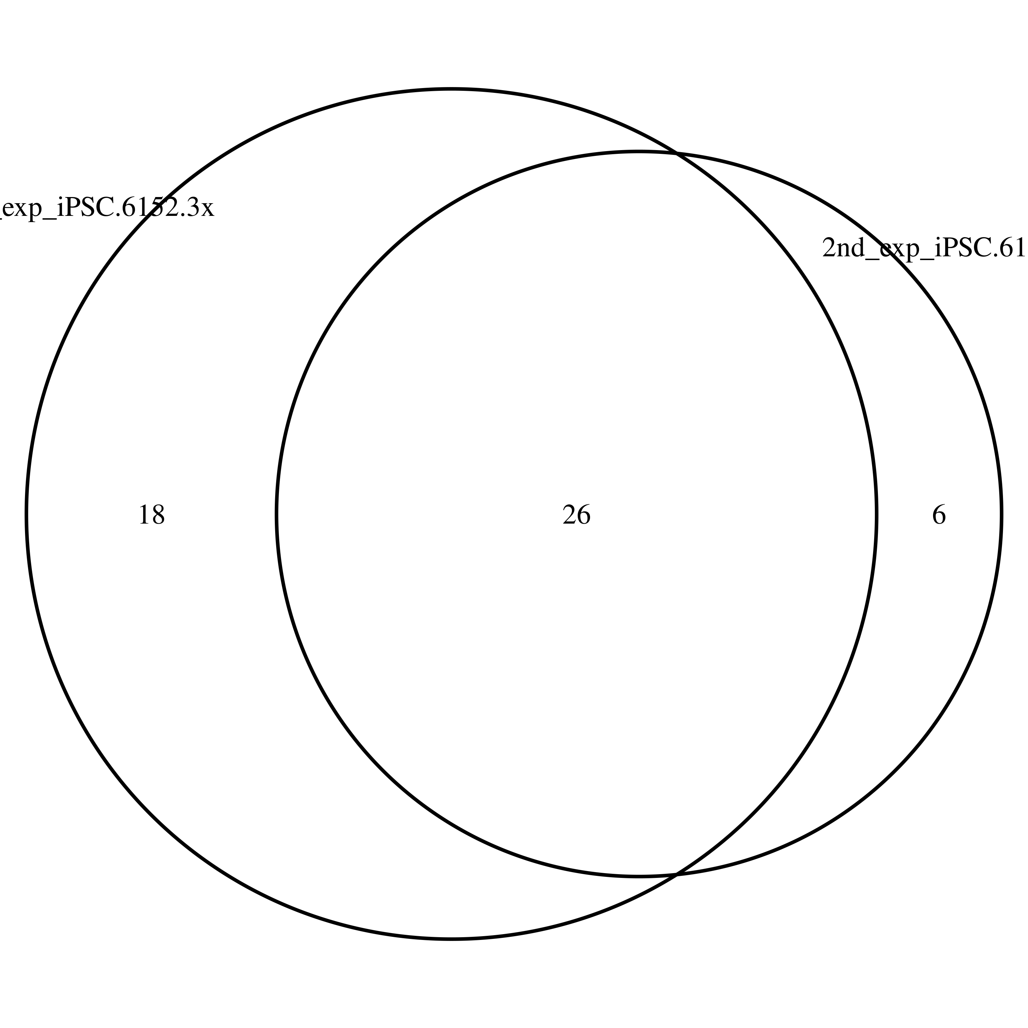
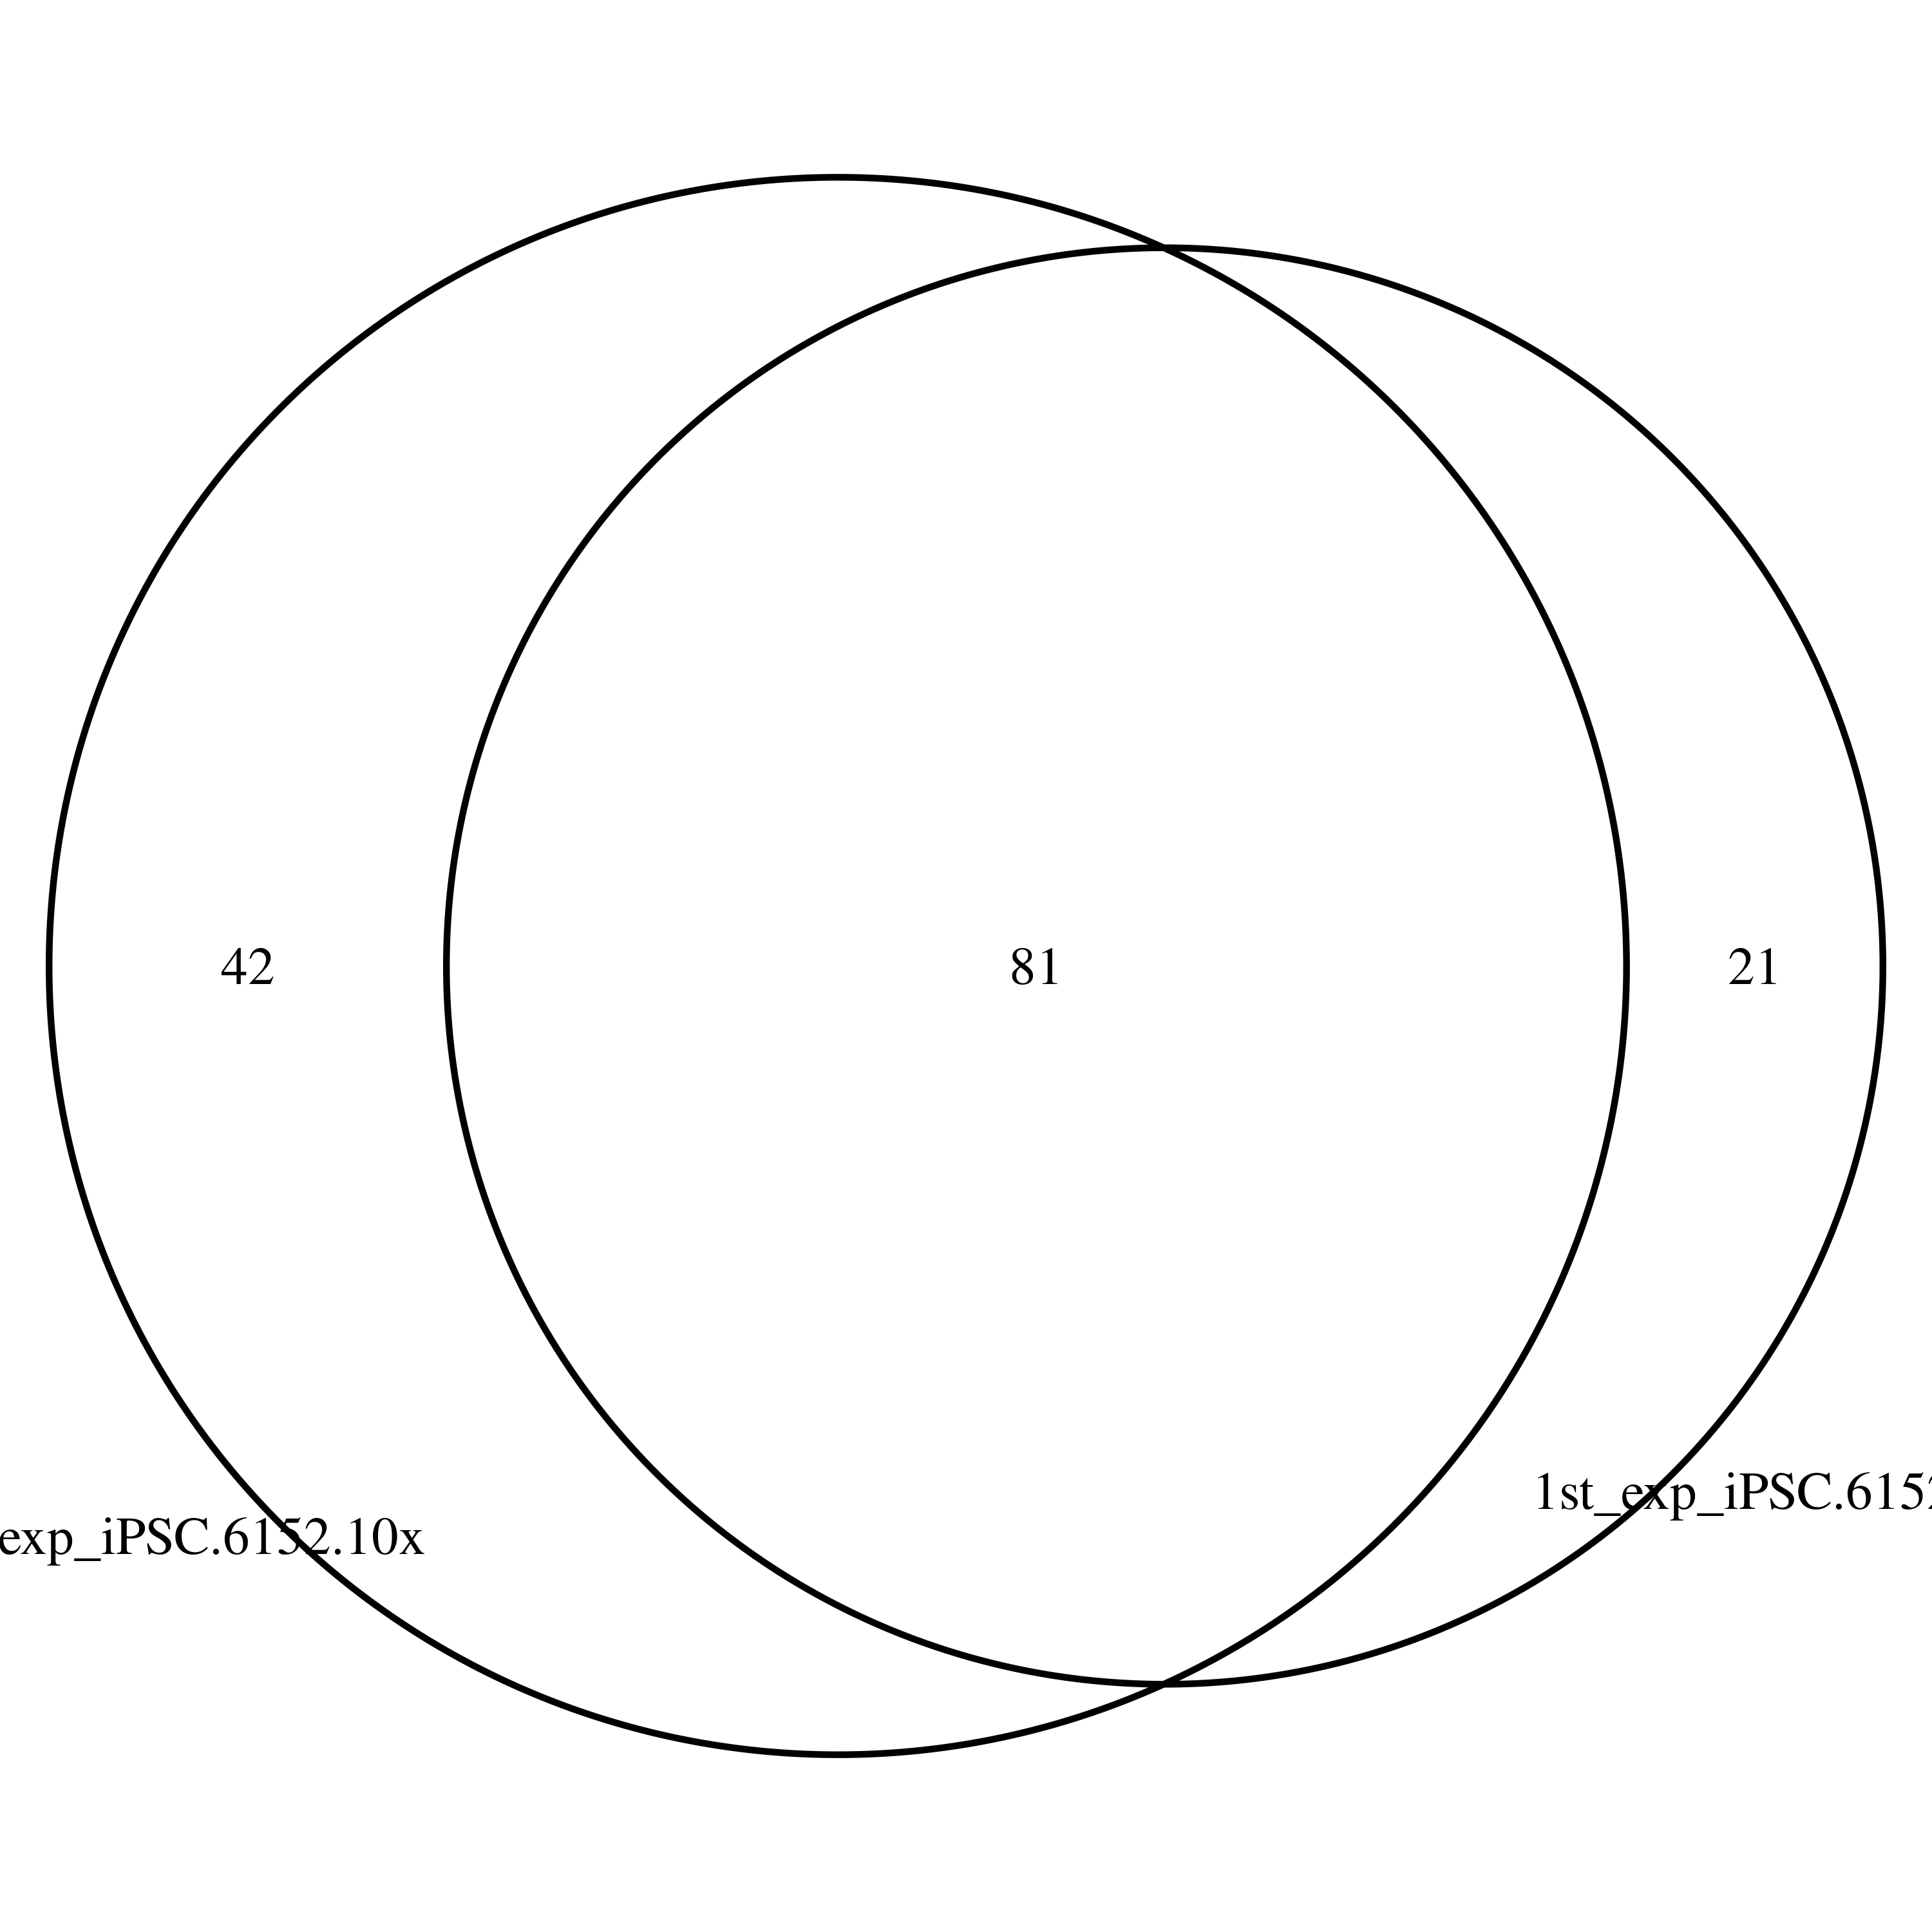
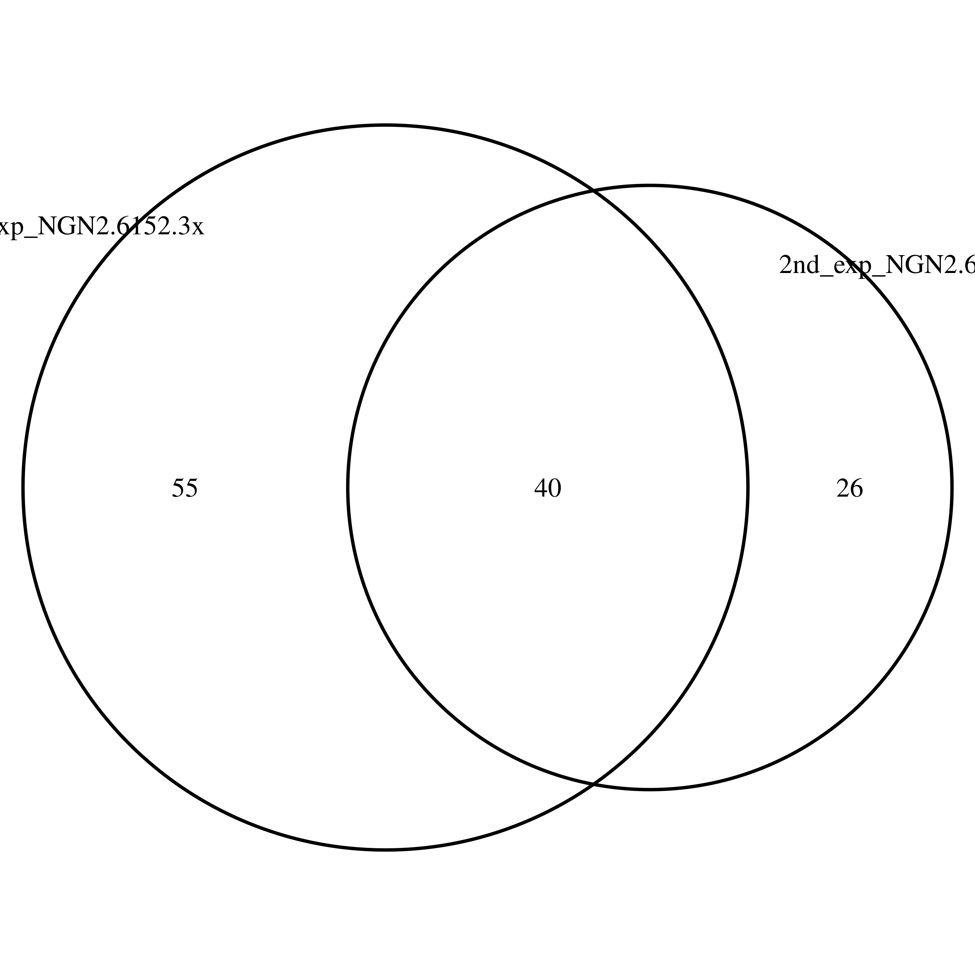
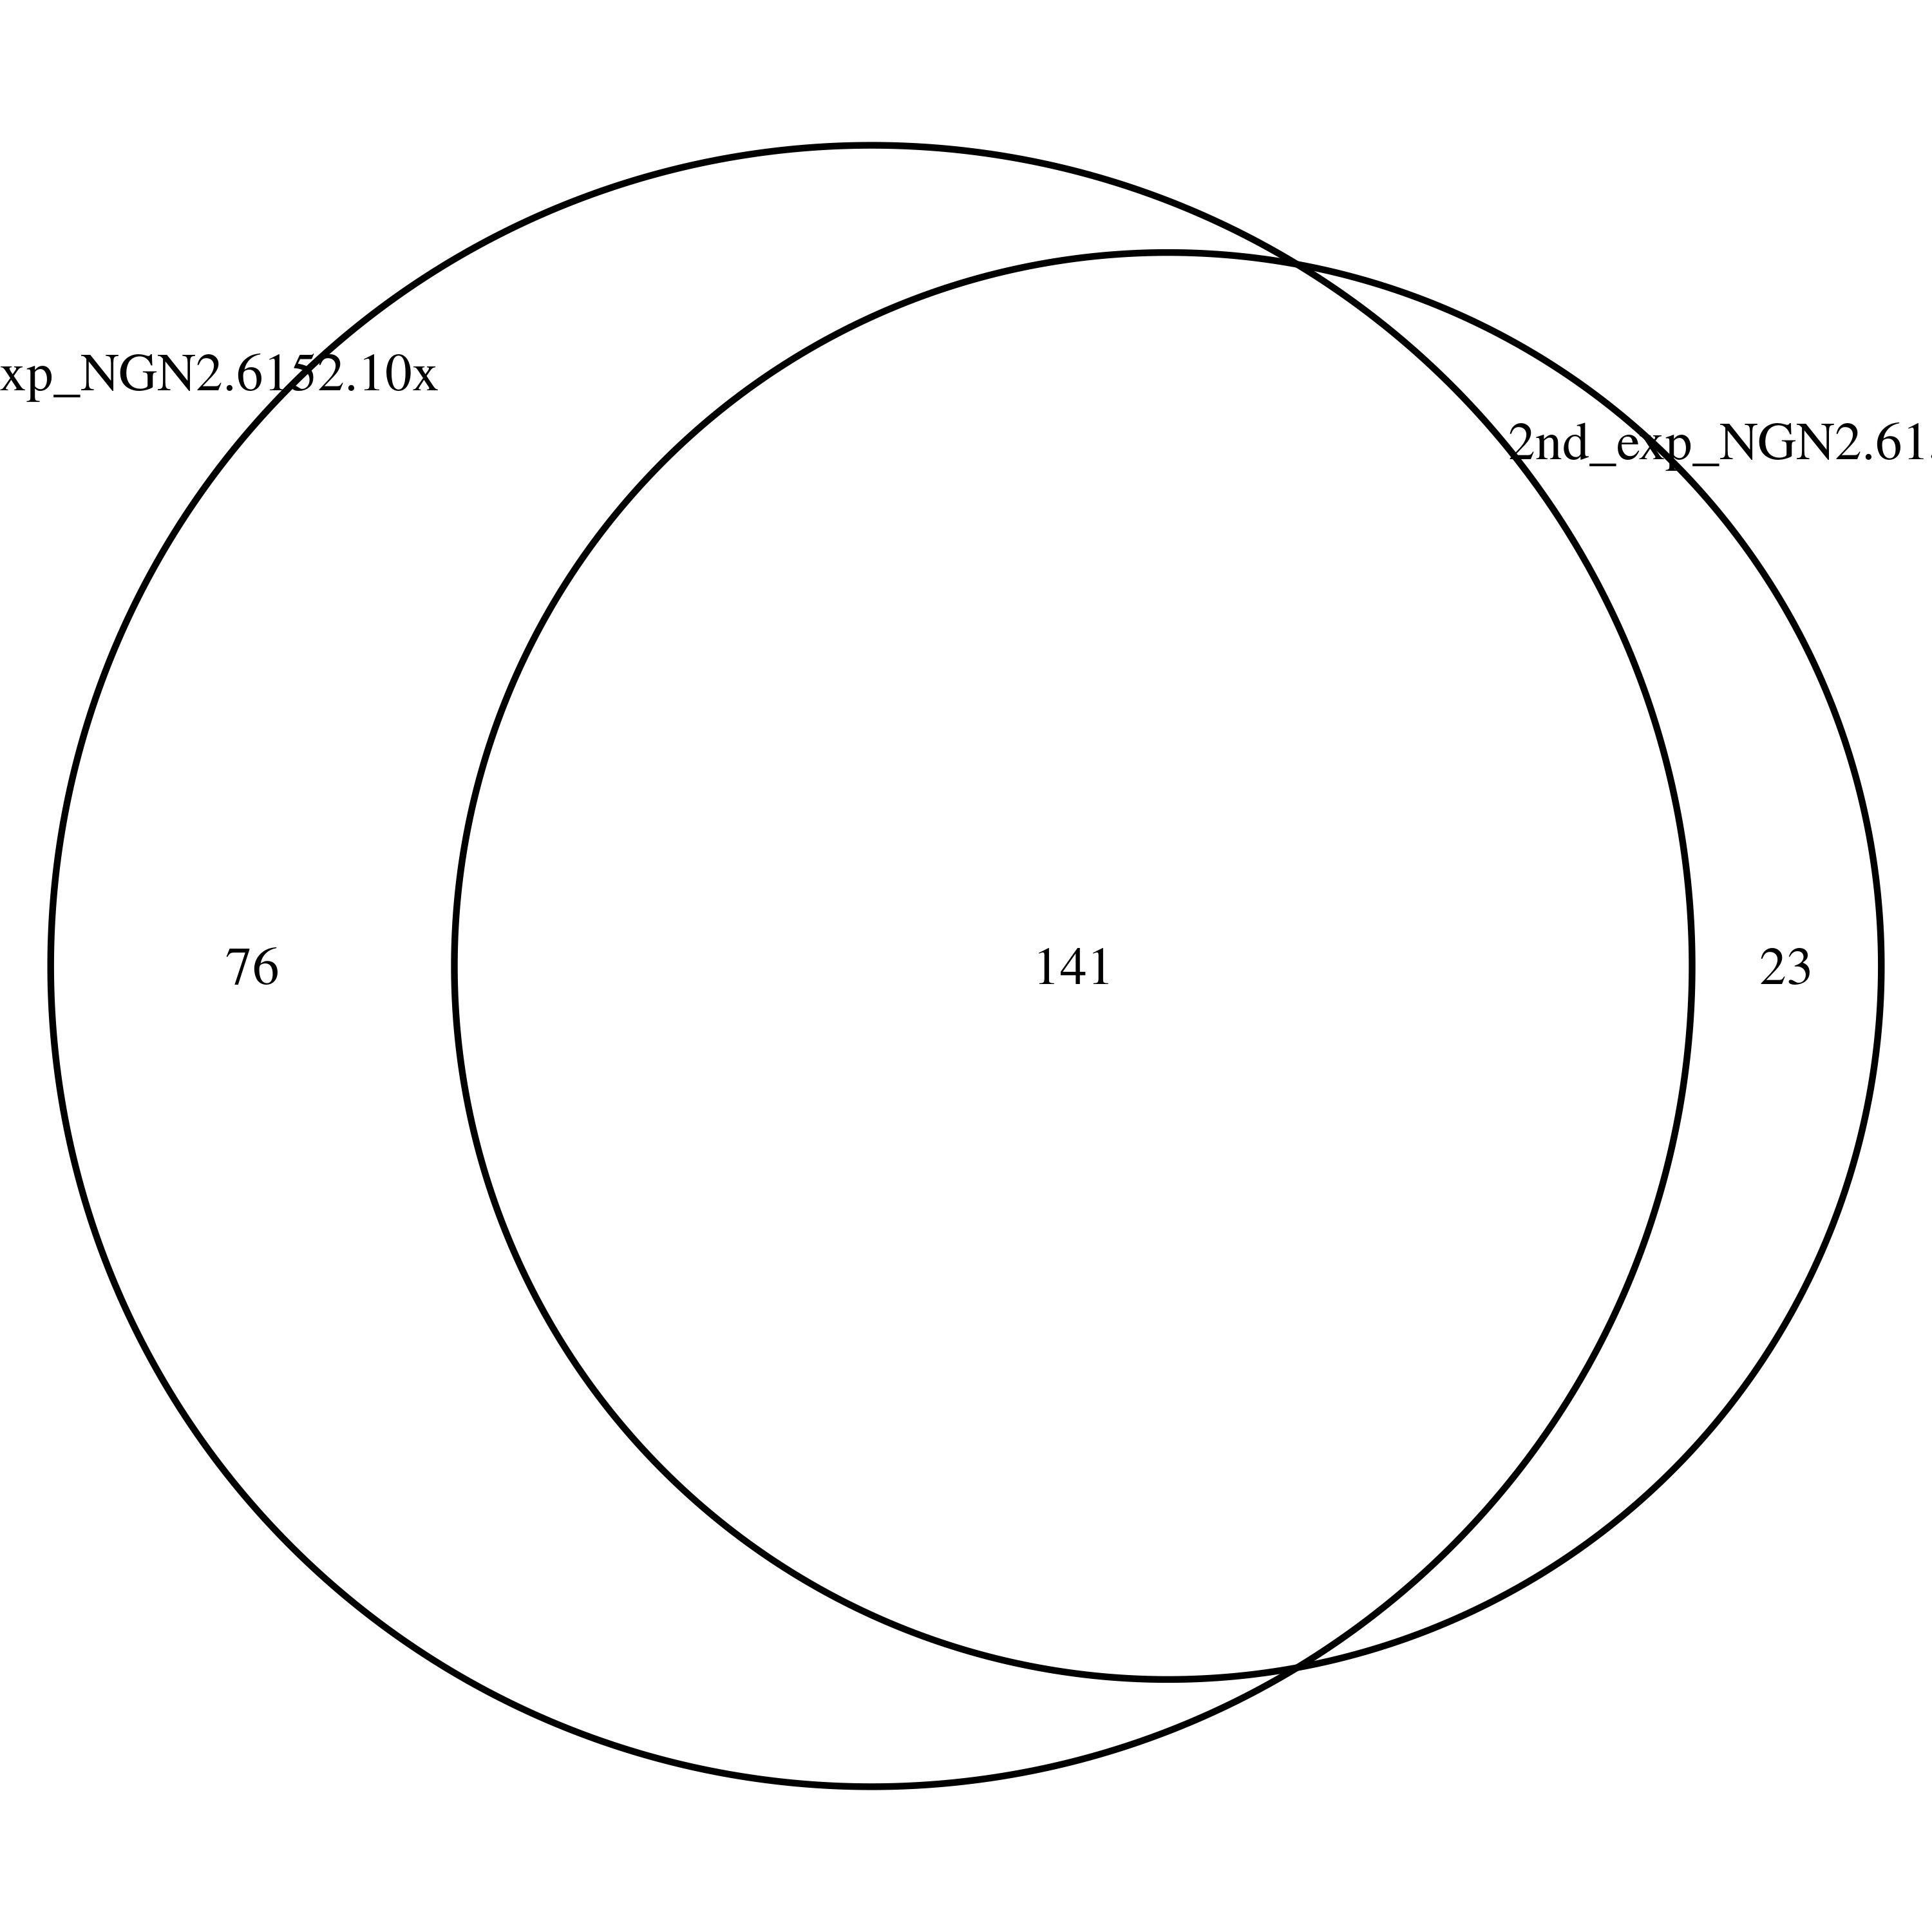
Overlapped DSG (1st and 2nd batch)
1st and 2nd batch of 6152-3x in iPSC
1st and 2nd batch of 6152-3x in NGN2
1st and 2nd batch of 6152-10x in NGN2
1st and 2nd batch of 6152-10x in iPSC

Slide 19
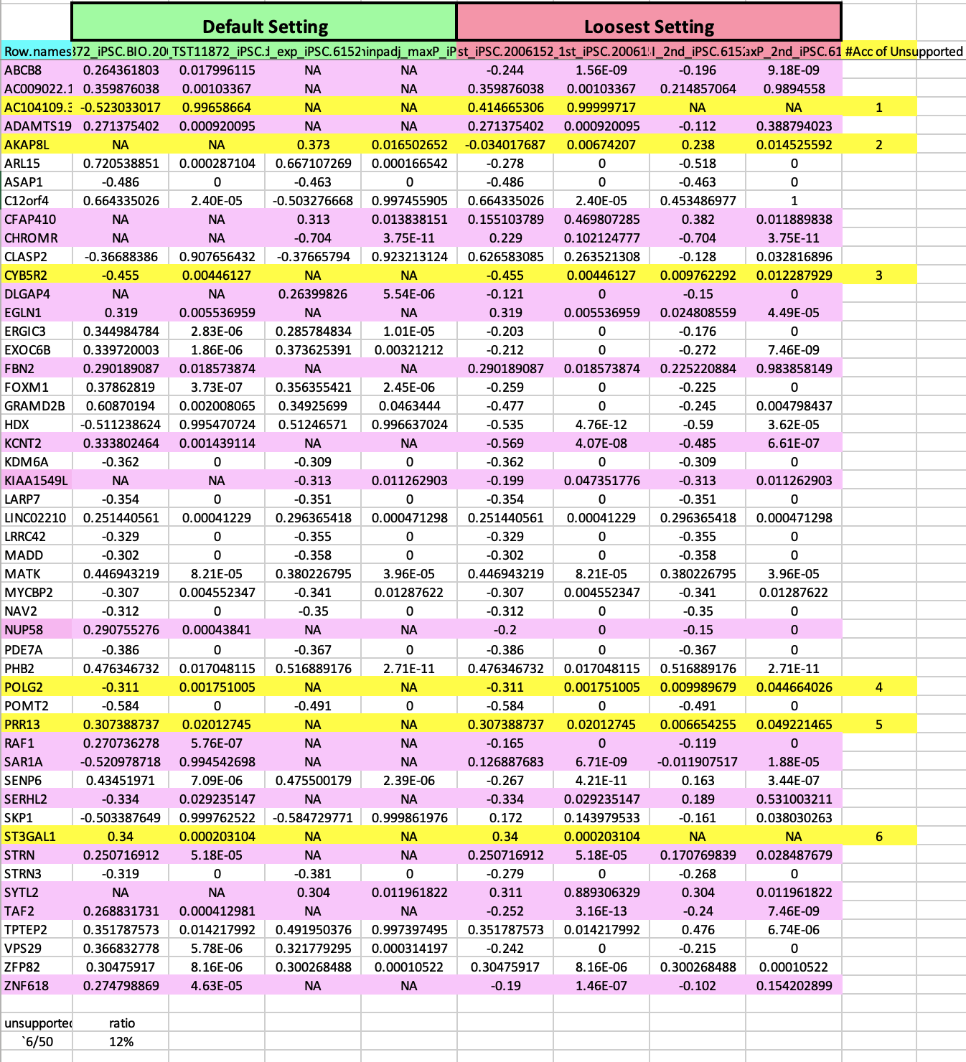
Overlapped DSG (1st and 2nd batch mutual support)
1st and 2nd batch of 6152-3x in iPSC

Slide 20
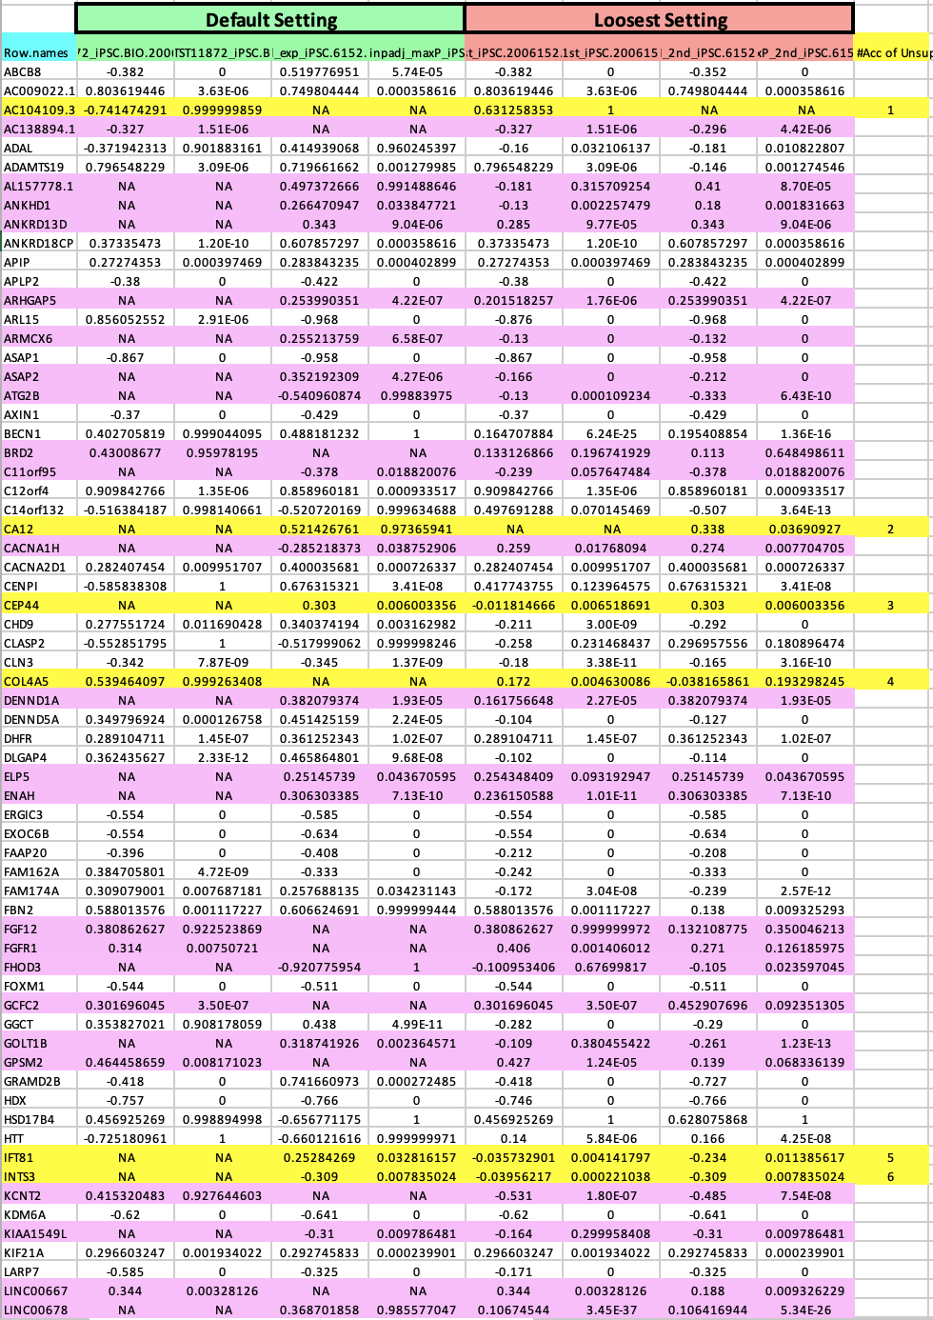
Overlapped DSG (1st and 2nd batch mutual support)
1st and 2nd batch of 6152-10x in iPSC

Slide 21
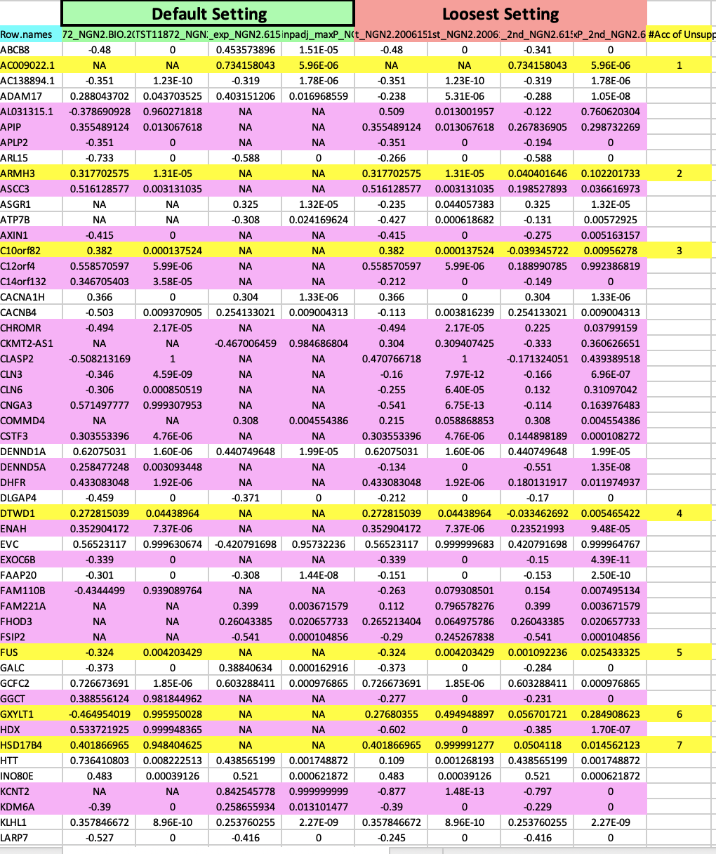
Overlapped DSG (1st and 2nd batch mutual support)
1st and 2nd batch of 6152-3x in NGN2

Slide 22
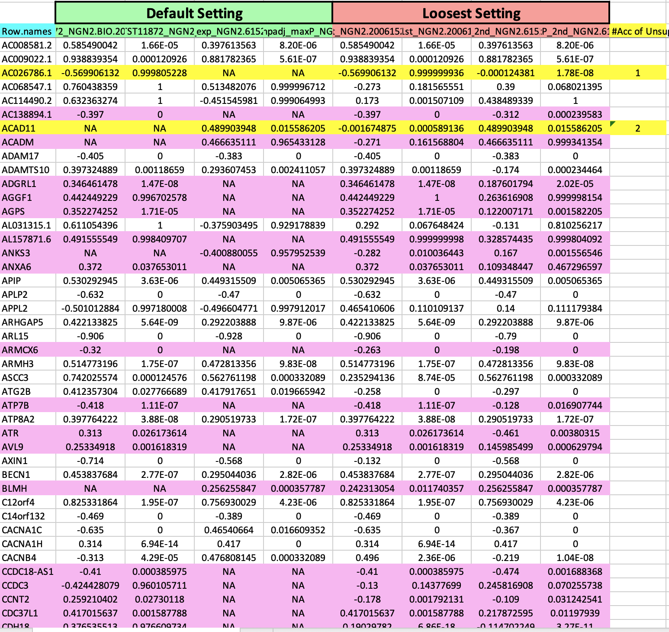
Overlapped DSG (1st and 2nd batch mutual support)
1st and 2nd batch of 6152-10x in NGN2

Slide 23
Overlapped DSG
iPSC vs NGN2 cells
1st batch vs 2nd batch
DSG consistency
Across compounds comparison

Slide 24
Sample similarity from Gene Expression
Expression heatmap for iPSC
Expression heatmap for NGN2

Slide 25
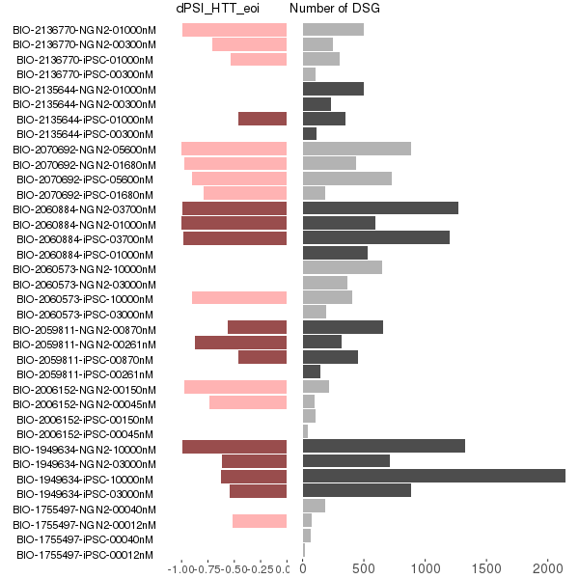
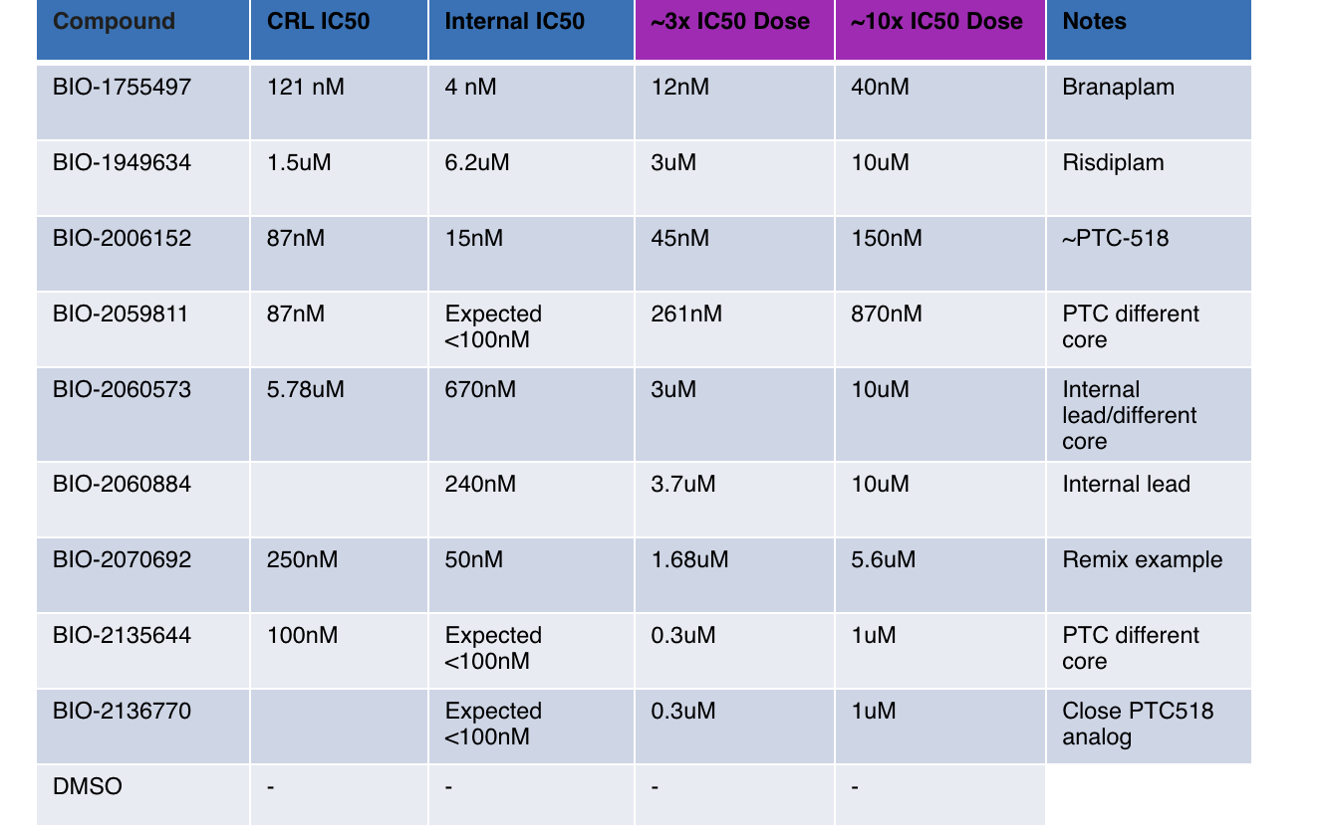
DSG and dPSI in eoi

Slide 26
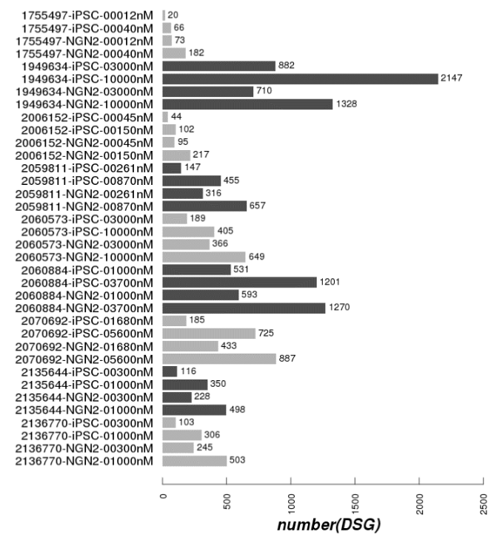
26

Slide 27
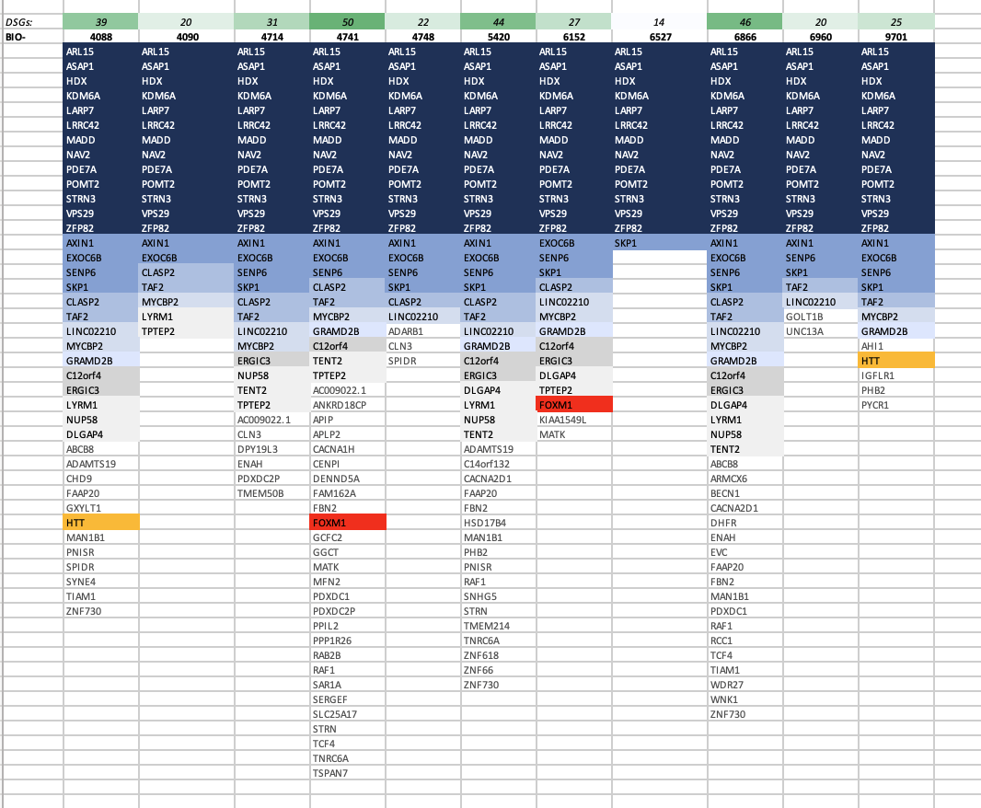
Compounds consistency
DSG across multiple compounds in iPSC cells

Slide 28
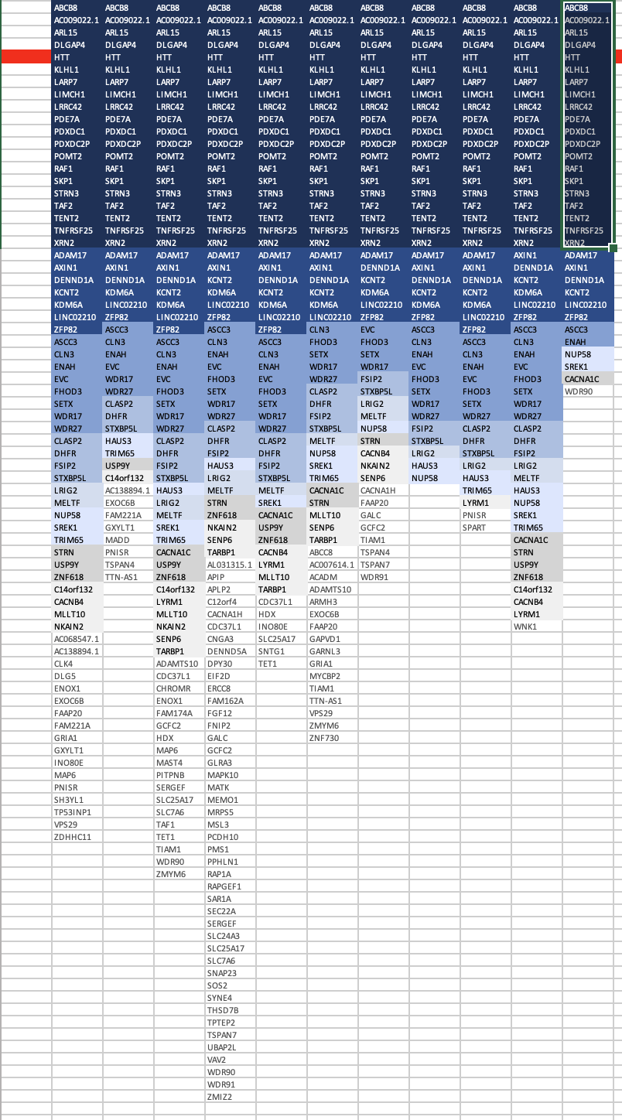
Compounds consistency
DSG across multiple compounds in NGN2 cells

Slide 29
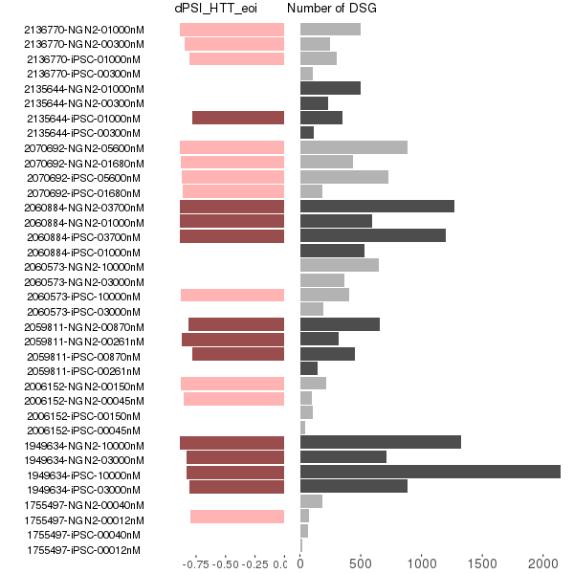
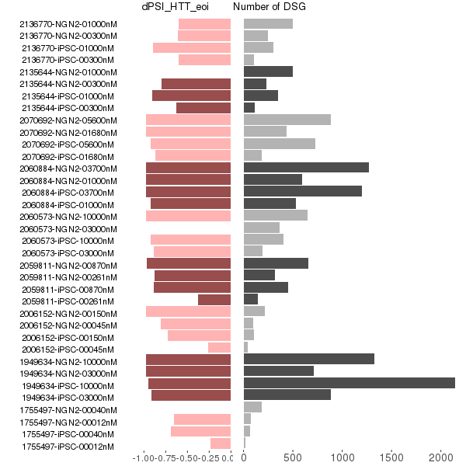
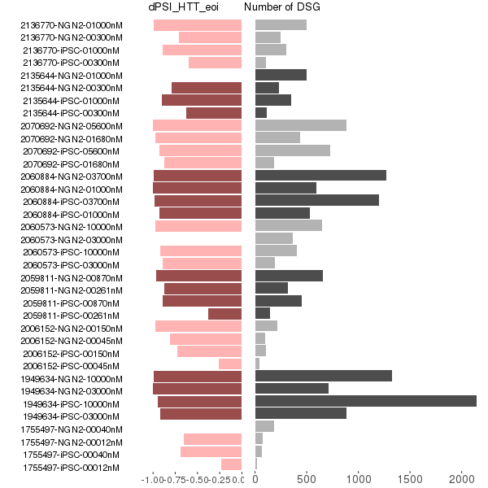
DSG and dPSI in eoi (1st batch)
Updated dPSI from leafcutter
dPSI from majiq
leafcutter majiq merged

Slide 30
Overlapped DSG (1st and 2nd batch)
1st and 2nd batch of 6152-3x in iPSC
1st and 2nd batch of 6152-3x in iPSC
1st and 2nd batch of 6152-3x in NGN2
1st and 2nd batch of 6152-10x in iPSC

Slide 31
Overlapped DSG (1st and 2nd batch mutual support)
1st and 2nd batch of 6152-3x in iPSC

Slide 32
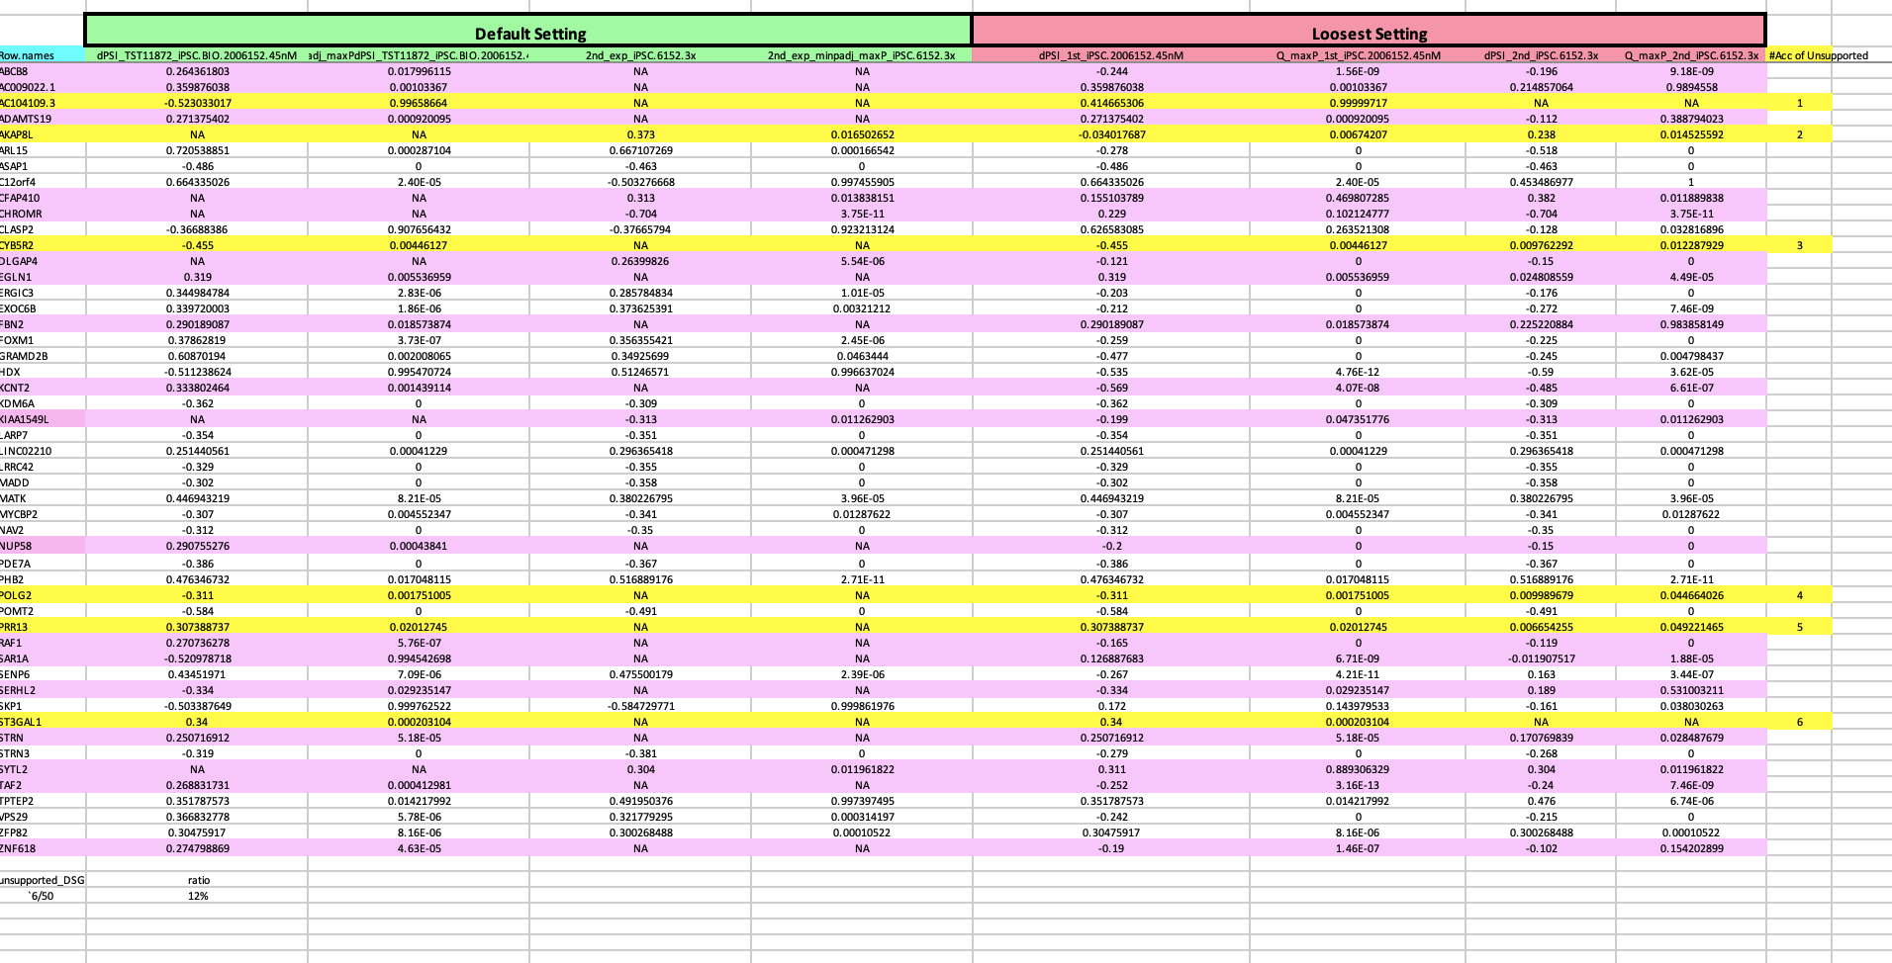
Overlapped DSG (1st and 2nd batch)
1st and 2nd batch of 6152-3x in iPSC
1st and 2nd batch of 6152-3x in iPSC
1st and 2nd batch of 6152-3x in NGN2
1st and 2nd batch of 6152-10x in iPSC

Slide 33
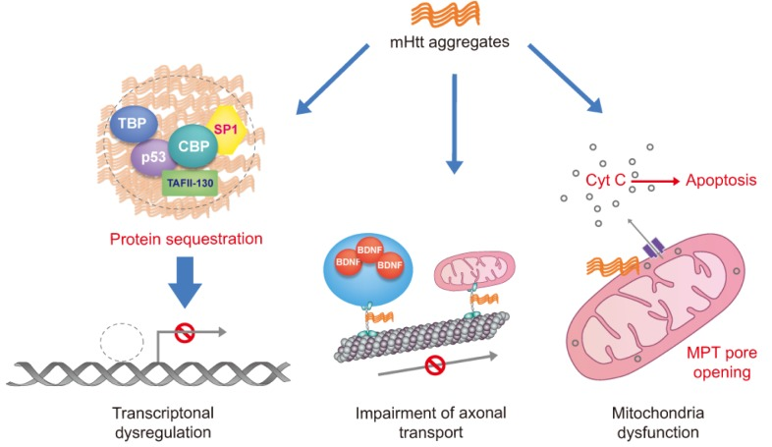
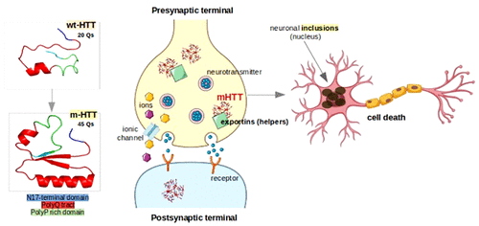
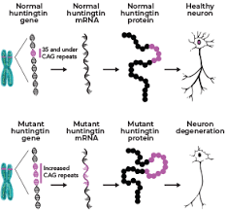
Huntingtin protein (HTT) and Huntington Diseass (HD)
(A)
(B)
(C)
mHTT is believed be responsible for Huntington’s Disease (HD)
wtHTT contains fewer (not more than 35 Qs) polyglutamine residues while mHTT has more than 35 Qs
A general assumption: short polyP domain is that it might act as an antagonist for β-sheet formation and keep HTT soluble
Plots from Sanda Nastasia et al.

Slide 34
Issues about the 2nd batch HTT competitors and internal compounds
Sep 26, 2022
Zhen, Dann, Catherine, Joon, Magnus, Jessica

